Slide 1
MA 276: Sports and statistics Lecture 1: What is sports and statistics?

Slide 2
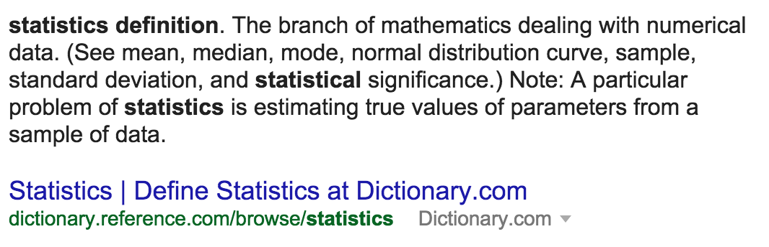
What is statistics?
Bad definition:
ii) Better definition:
‘Science of learning from data’ – Marie Davidian

Slide 3
What is statistics in sports?
‘Science of learning from data’ in sports
1) Wrangle & visualize data
2) Statistical tool
- Ex: Regression, t-test, etc
3) Measure uncertainty
- Practical vs. statistical significance
4) Communicate results
- Appropriate generalizability
What am I missing?

Slide 4
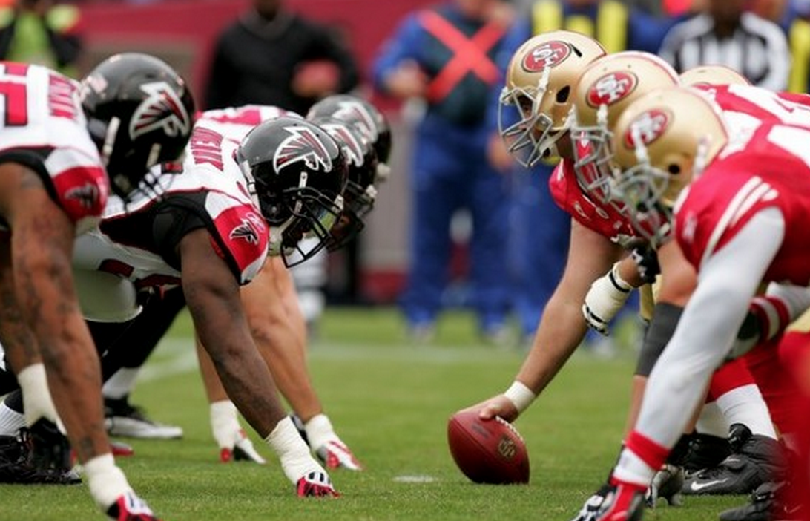
Wrangle data
Start with:

Slide 5
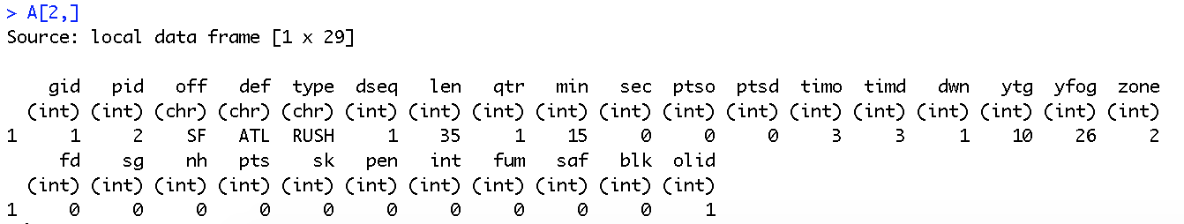
Wrangle data
End with:

Slide 6
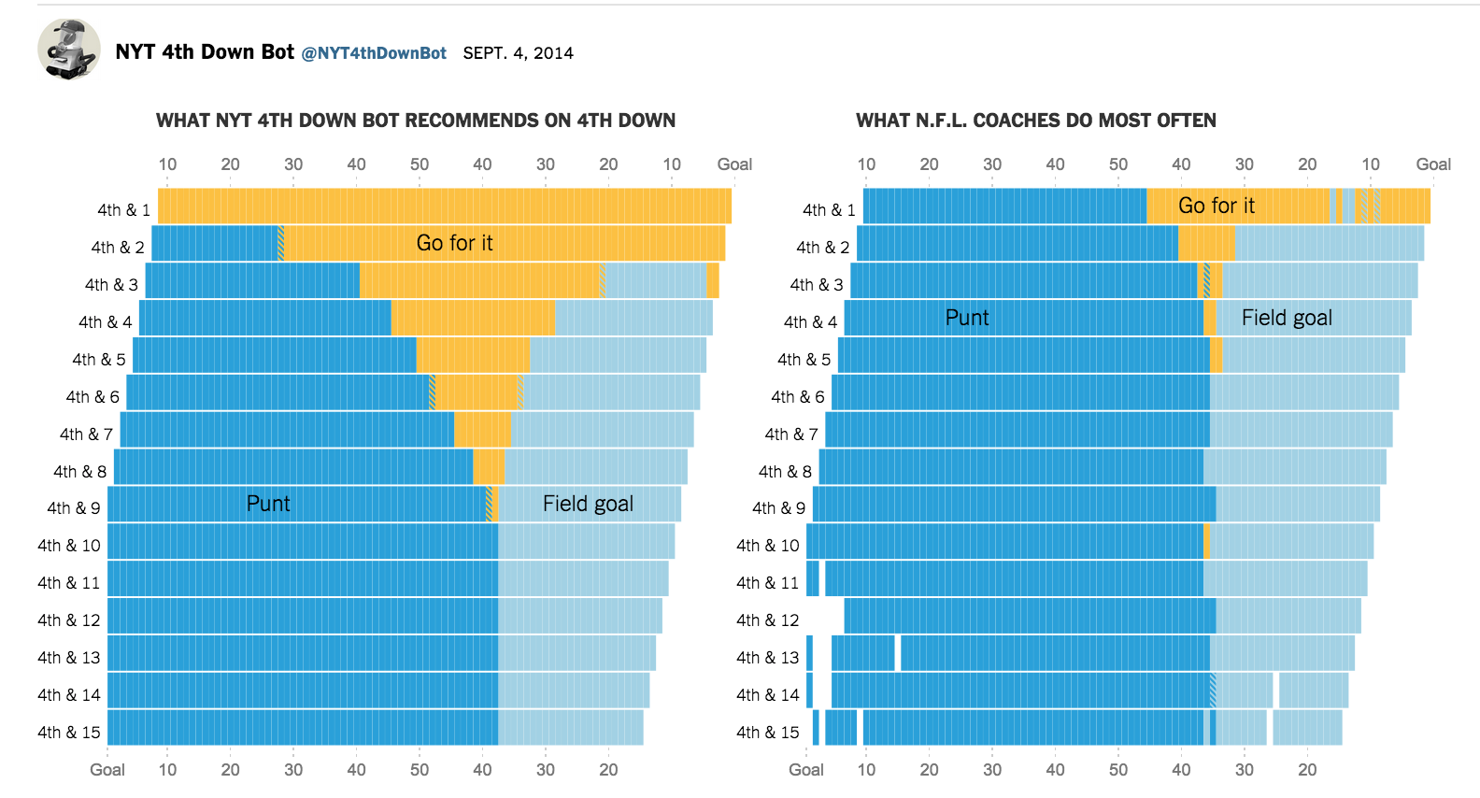
Visualizing data

Slide 7
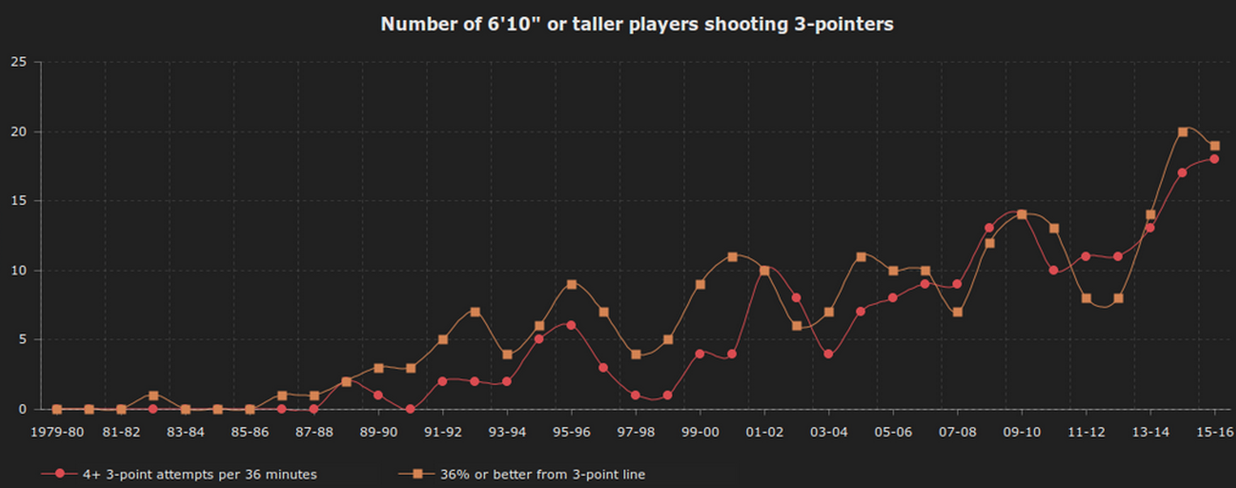
Visualizing data
http://nyloncalculus.com/2016/01/12/torontos-power-forwards-firing-away-corners/

Slide 8
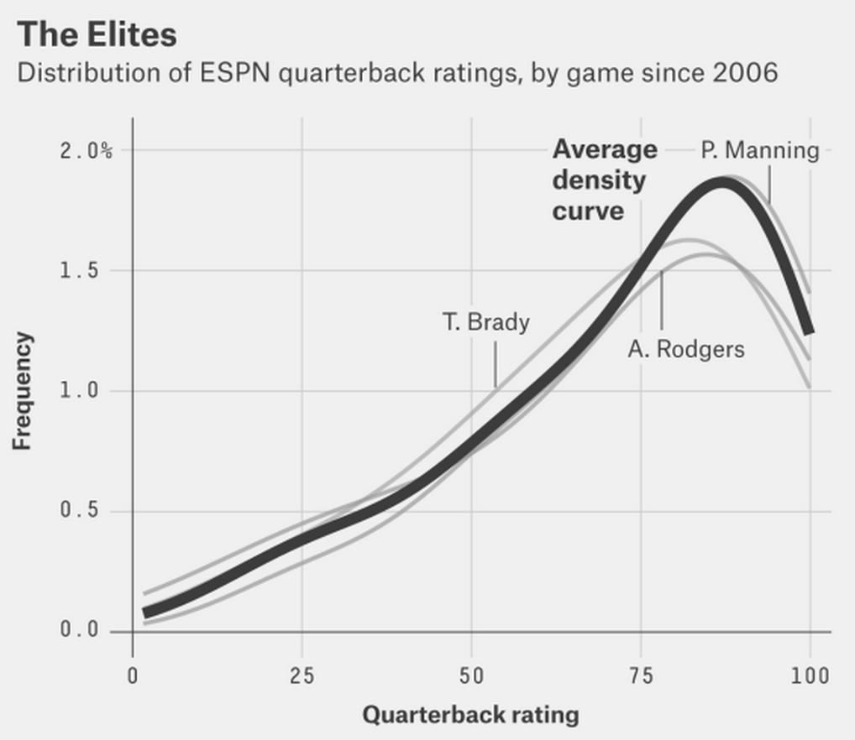
Visualizing data
http://fivethirtyeight.com/features/the-10-types-of-nfl-quarterbacks/

Slide 9
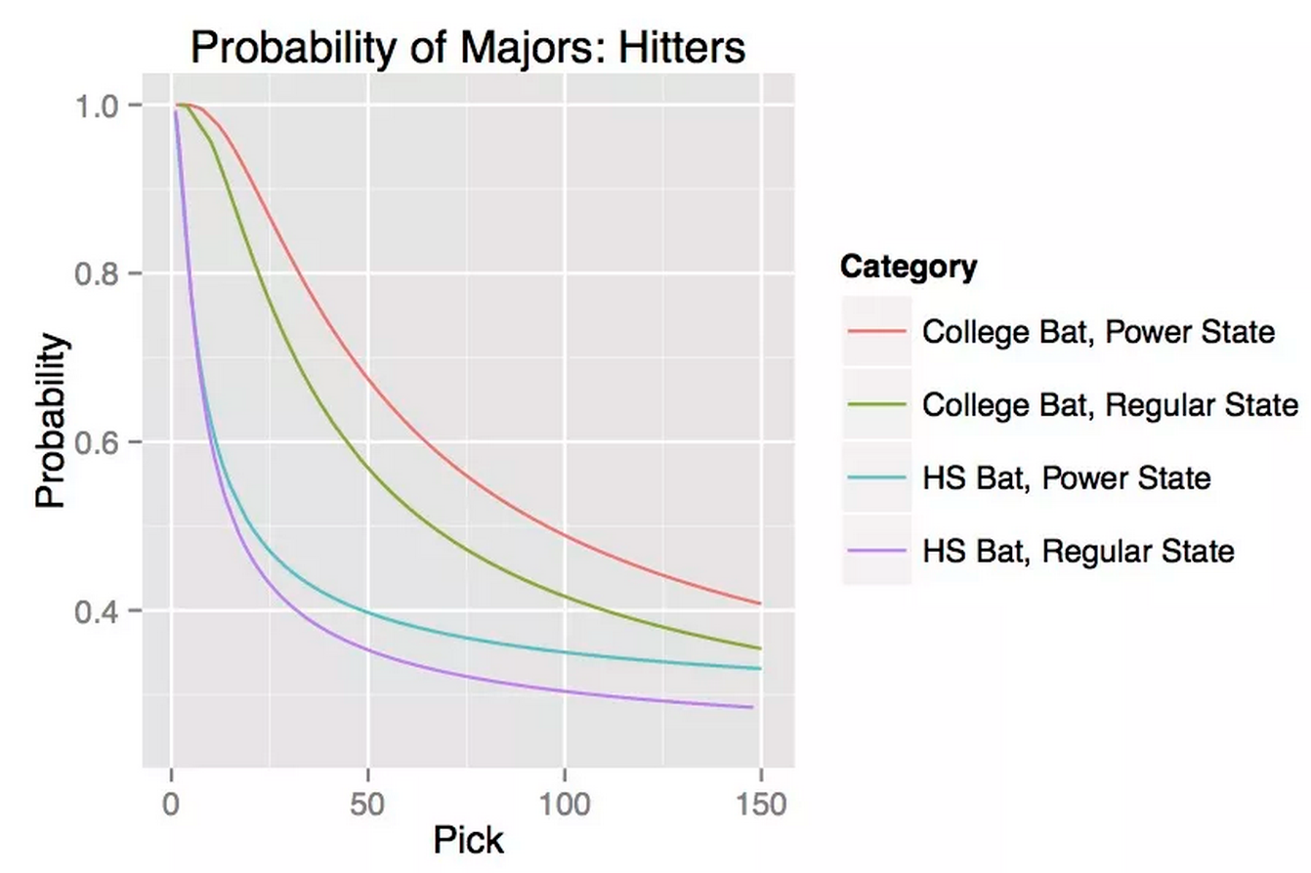
Statistical tool
http://www.beyondtheboxscore.com/2015/3/23/8269695/geographic-bias-in-the-amateur-draft-part-2-1

Slide 10
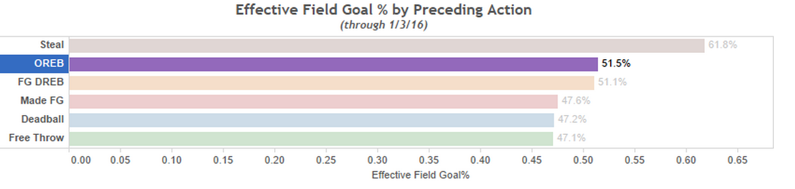
Statistical tool
http://nyloncalculus.com/2016/01/06/offensive-rebounds-and-three-pointers/

Slide 11
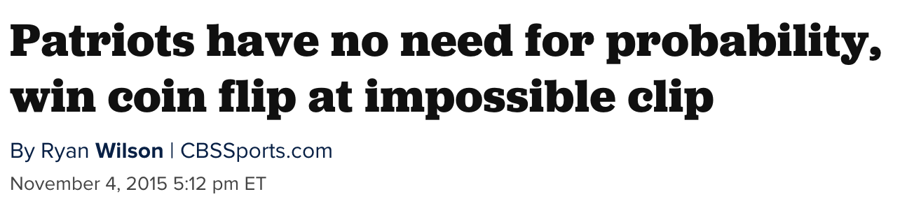
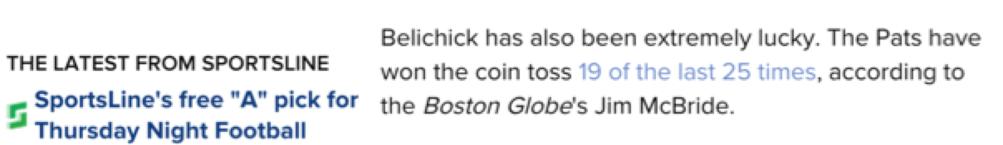
Statistical tool
www.cbssports.com/nfl/eye-on-football/25363570/patriots-have-no-need-for-probability-win-coin-flip-at-impossible-clip

Slide 12
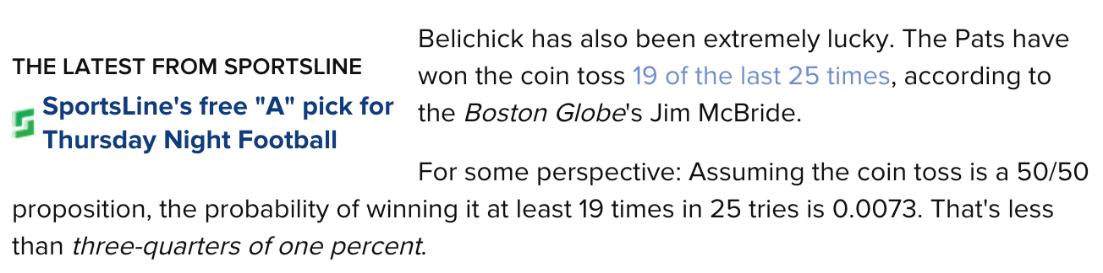
Statistical tool, account for uncertainty

Slide 13
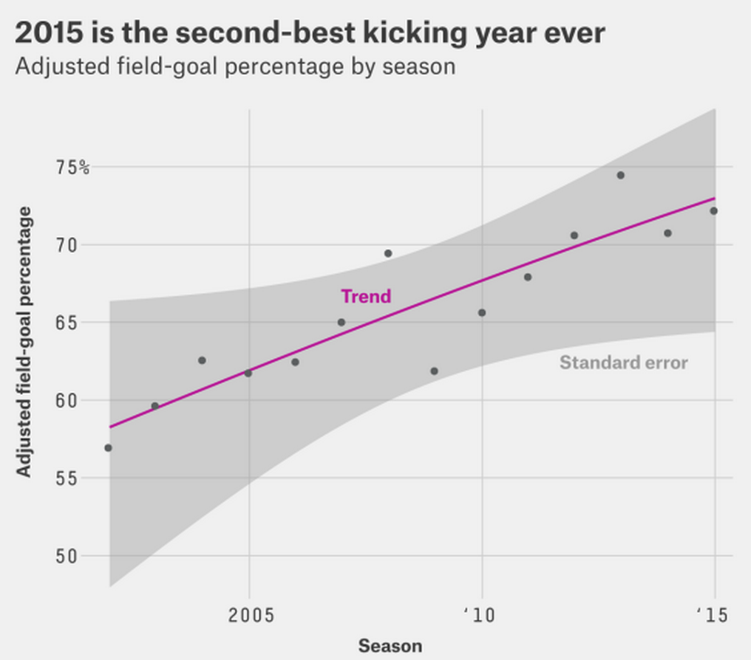
Statistical tool, account for uncertainty
http://fivethirtyeight.com/features/the-haters-are-losing-the-war-on-nfl-kickers/

Slide 14
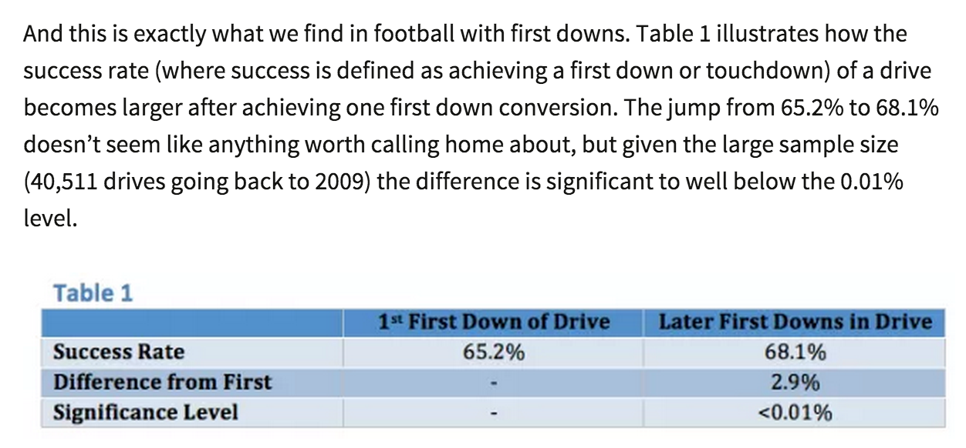
Statistical tool, account for uncertainty
http://harvardsportsanalysis.org/2014/09/4827/

Slide 15
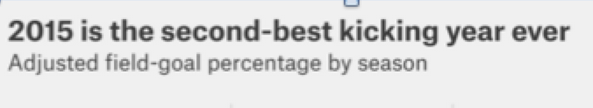
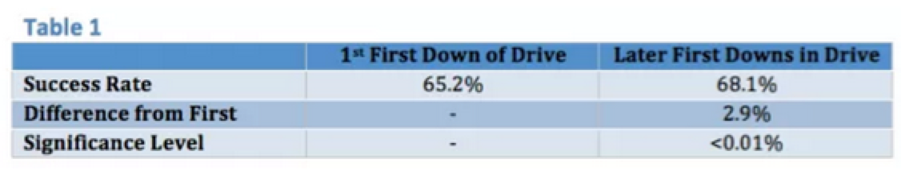
Significance: statistical? practical?

Slide 16
Recall: What’s a p-value?

Slide 17
Generalizability? Who? Where? When?

Slide 18
Recall: Population vs. sample

Slide 19
Rough history of statistics in sports
Jamesian era (1970’s – 2004ish)
- “Hey, you can apply statistics to sports!”
Modern era (2004ish – current)
- “Get more data, do cool stuff”
- “Get more data, do really cool stuff, get hired”
- Nomenclature change to a more sexier
“sports analytics”
Future (Current - ????)
- “Holy shit, we have too much data”

Slide 20

Jamesian era
Bill James Baseball Abstract, 1977
“Stein’s Paradox in Statistics” – 1977, Efron and Morris
“On the optimal time to pull the goalie” – 1976, Morrisonn
“Operations research in football” – Carter & Machol, 1971

Slide 21

Jamesian era

Slide 22

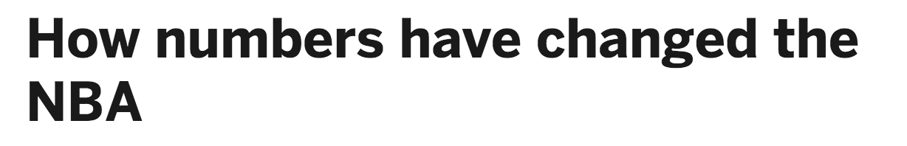
Modern era
“Get more data, do cool stuff”

Slide 23
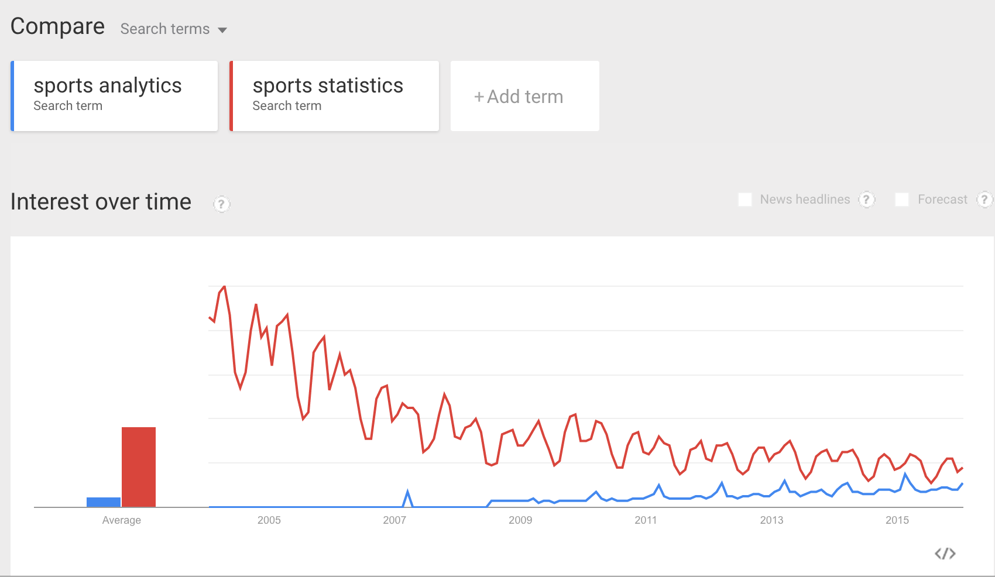
Modern era
Sports and statistics becomes sports analytics

Slide 24
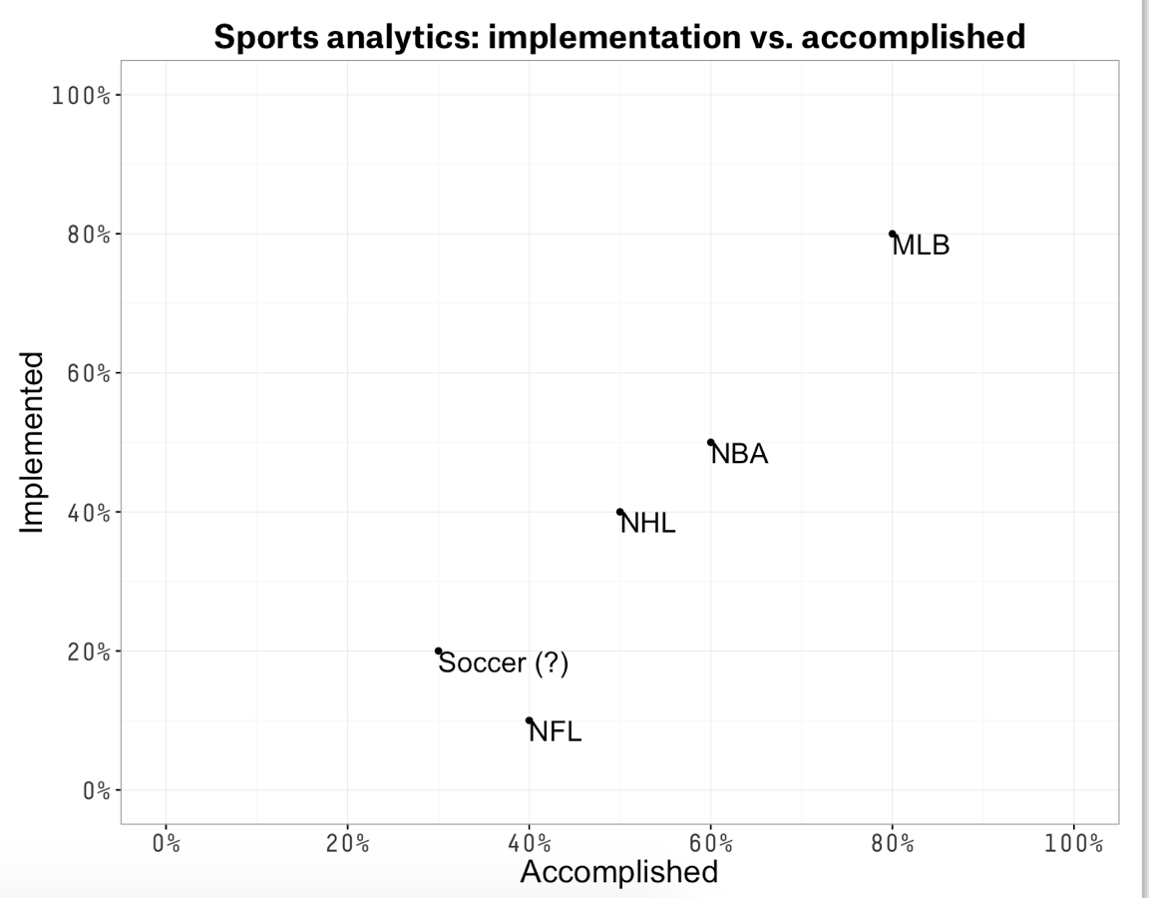
Modern era
Where do we stand? One man’s opinion (mine)

Slide 25
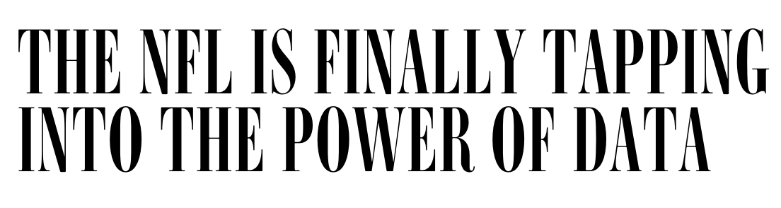
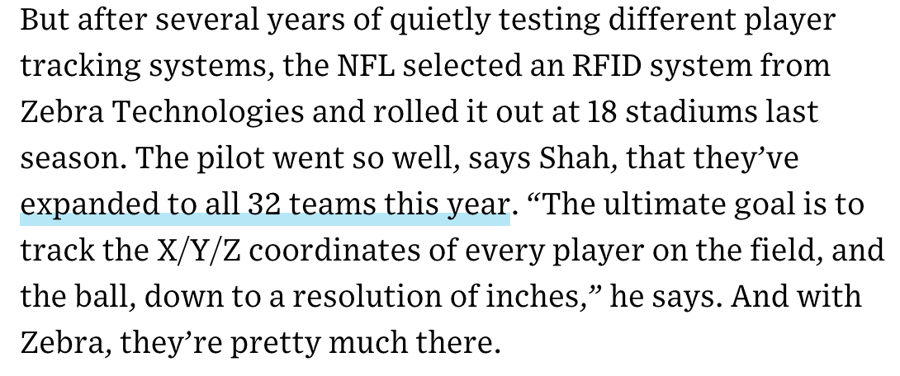
Future era
“Holy shit, we have too much data”

Slide 26
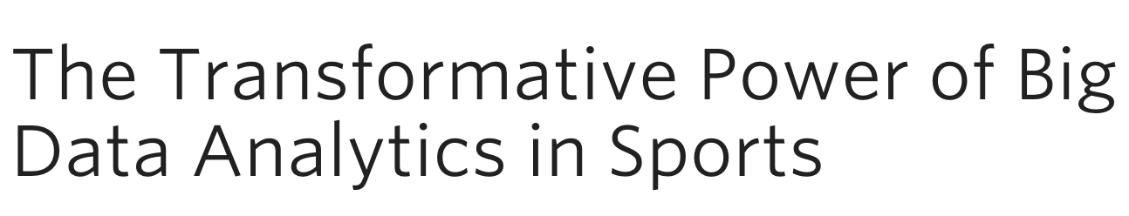
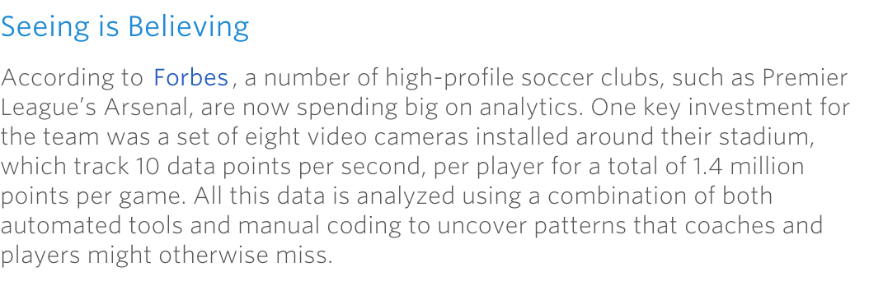
Future era
“Holy shit, we have too much data”

Slide 27
Where do we fit in?
Course Goals (from syllabus):
-Gain an understanding of how statistical tools have been applied in the sports world
-Learn advanced methods for analysis, visualization, and implementation
-Gain familiarity with nonparametric and parametric statistical tools
-Contrast in-sample versus out-of-sample statistics with respect to sports

